Slide 1
UNMANNED AERIAL VEHICLE (UAV)

Slide 2
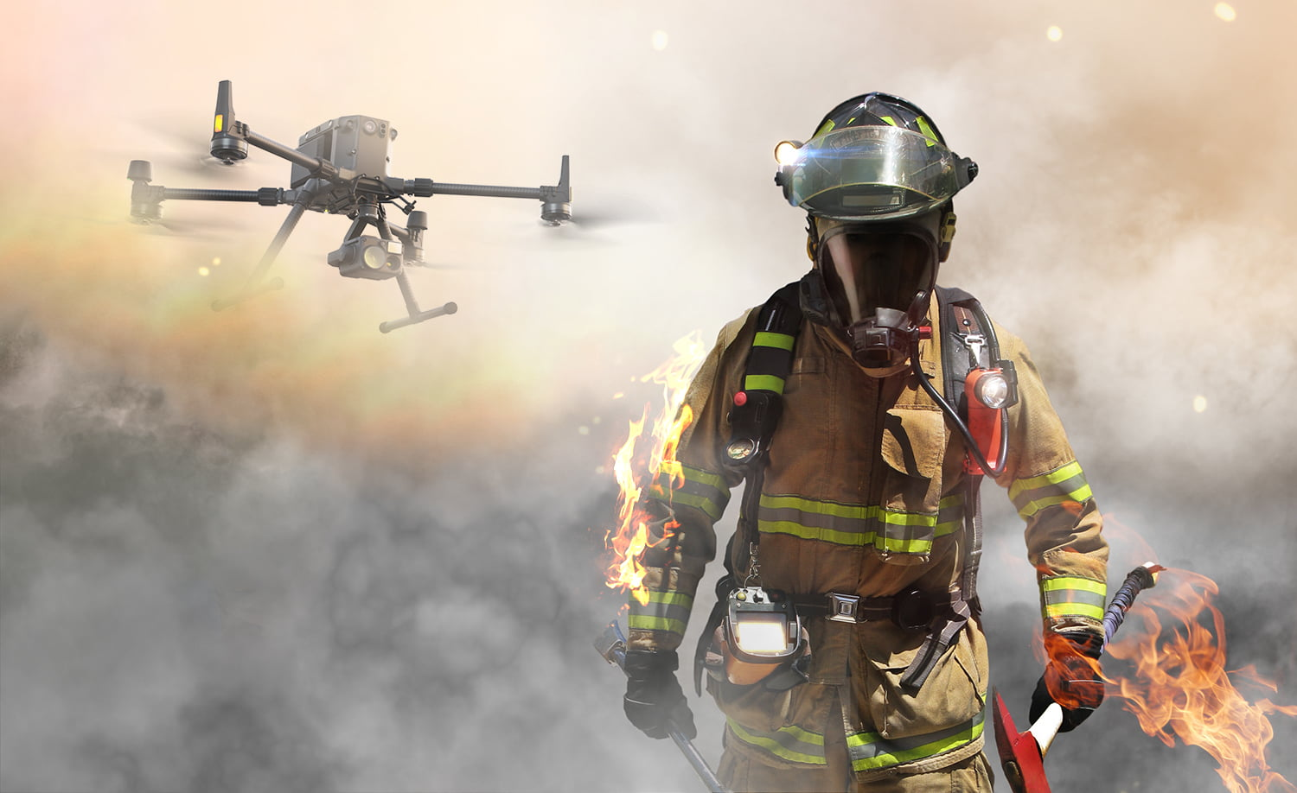
FIREFIGHTING DRONE

Slide 3
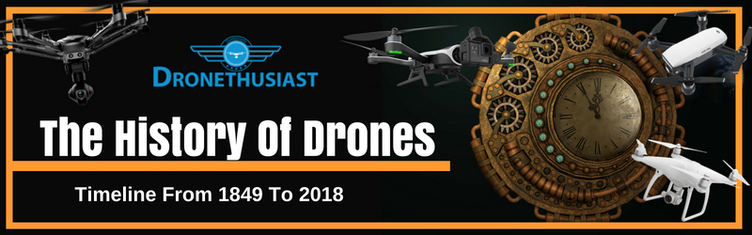
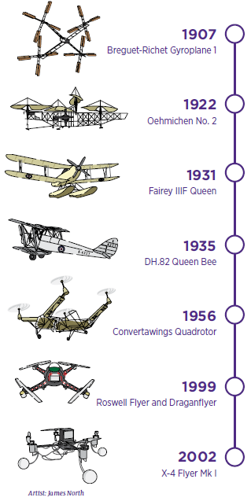
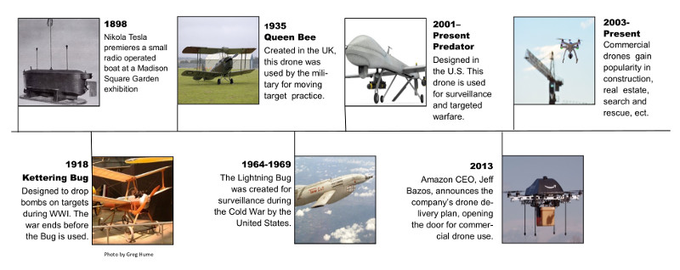

Slide 4
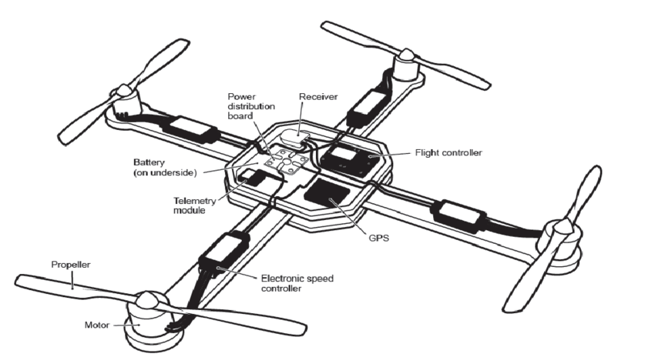
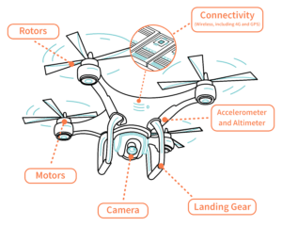
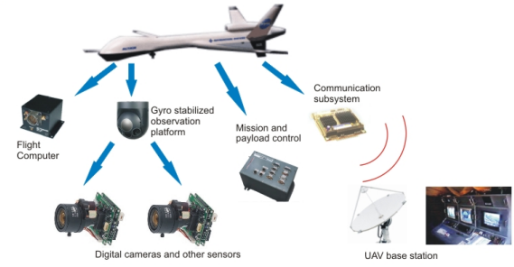
Basic System Architecture for UAVs
Every UAV uses the same components in order
to operate.
Flight Controller
Propellers
IMU
Communication system

Slide 5
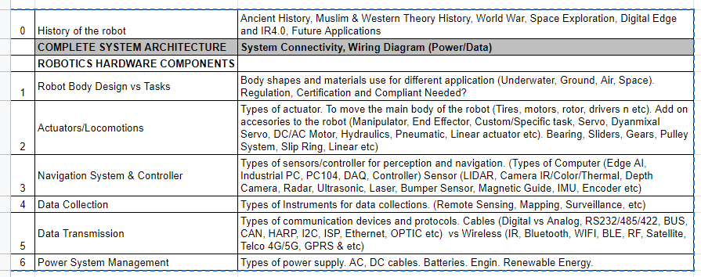

Slide 6
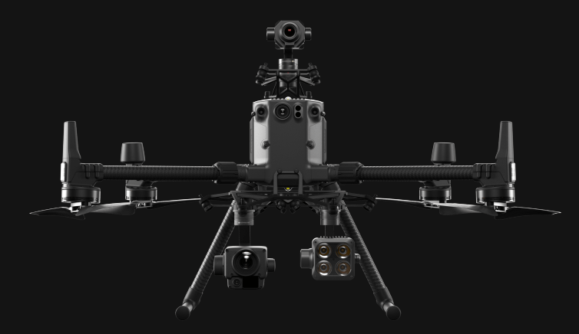
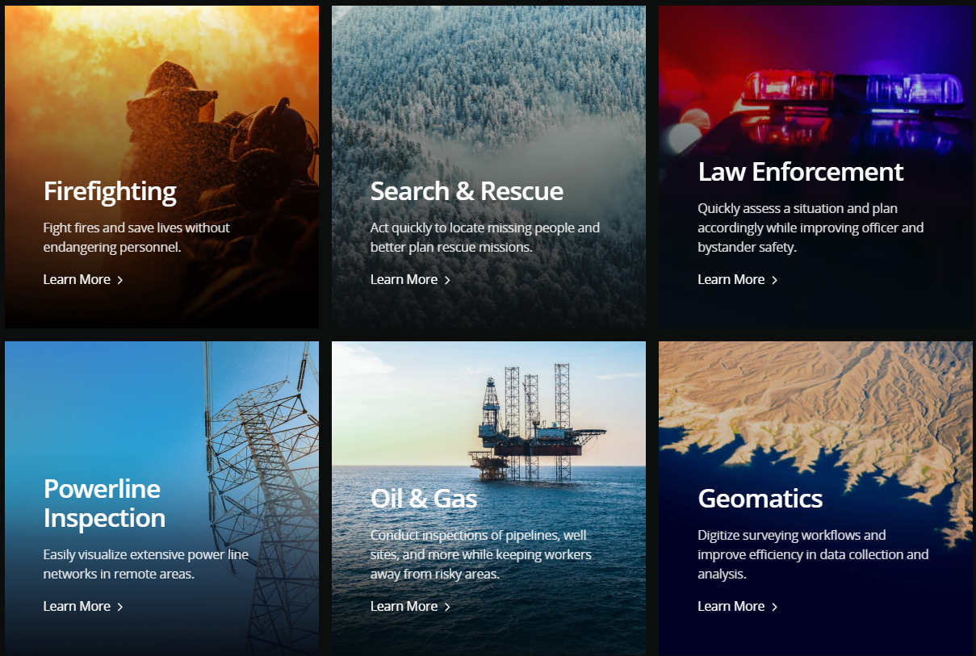
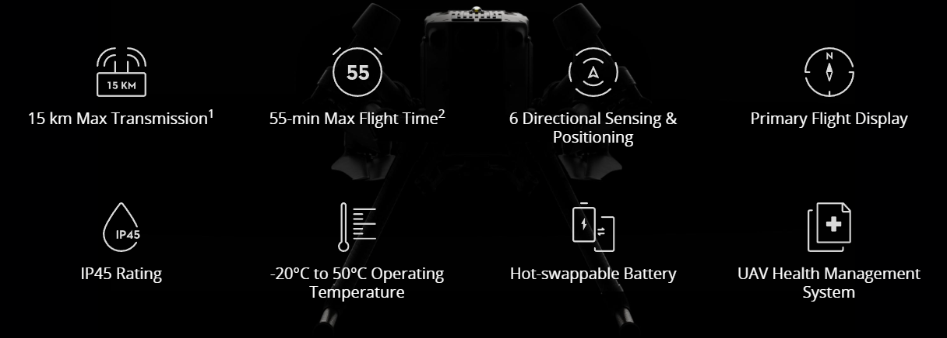
1) Robot Design Vs Task
Surveying the surrounding
MATRICE 300 RTK
The materials used for the body are designed to
carry out heavy tasks.

Slide 7
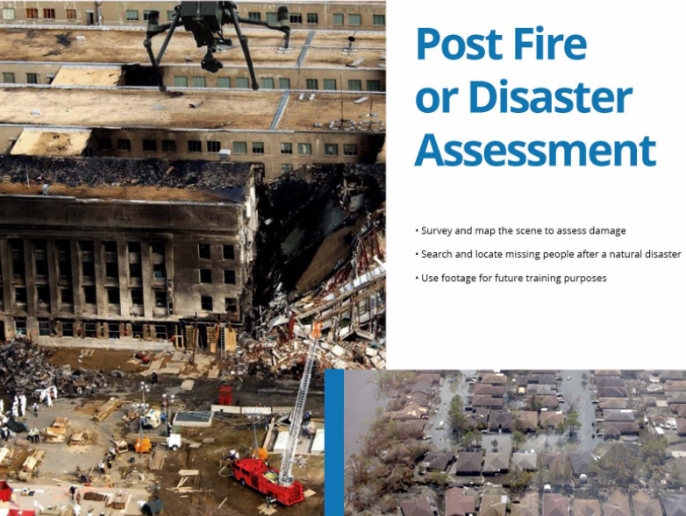
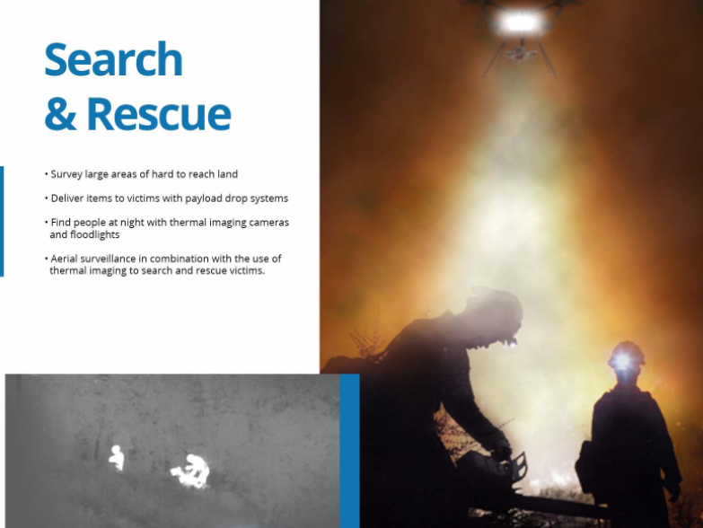
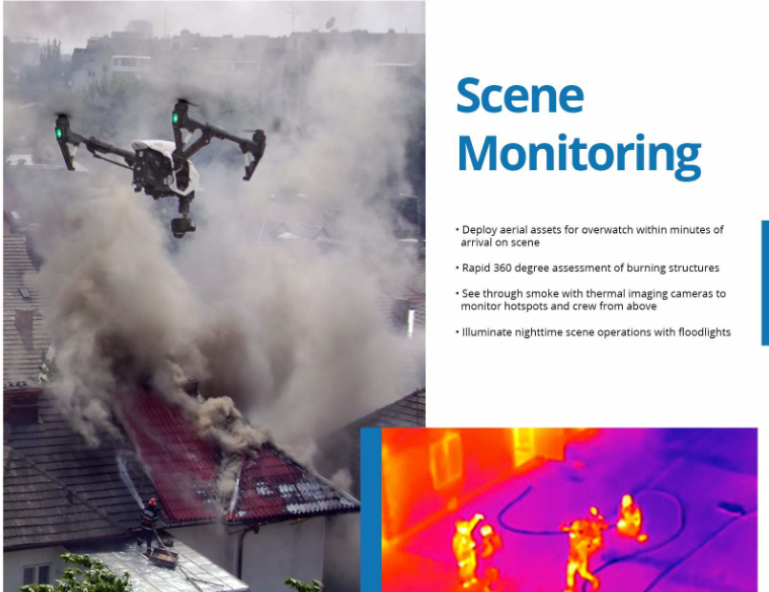
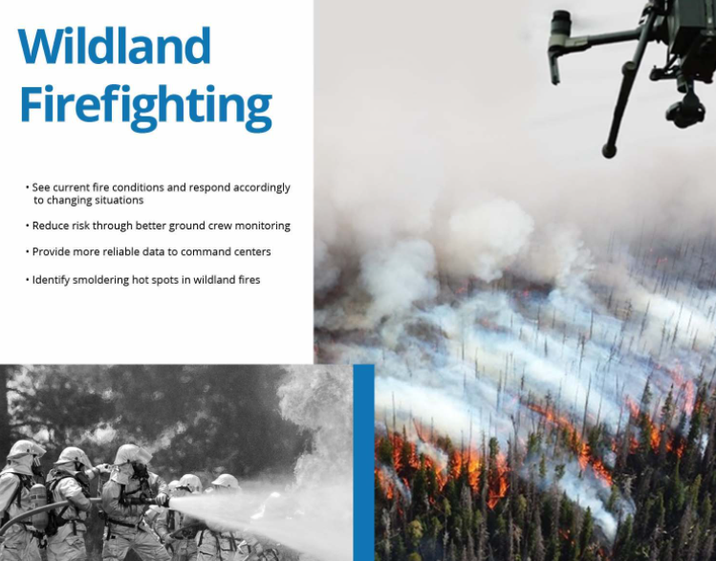

Slide 8
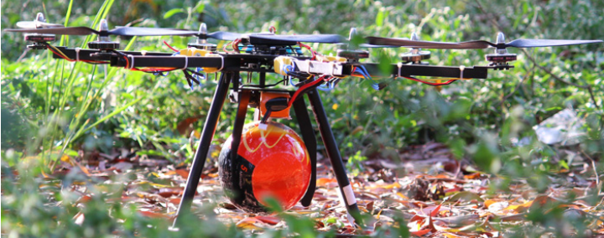
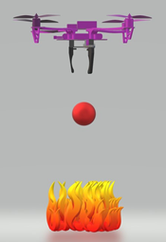
1) Robot Design Vs Task
Extinguishing Fire via dropping
fire extinguishing ball
Gripper is used as attachment

Slide 9
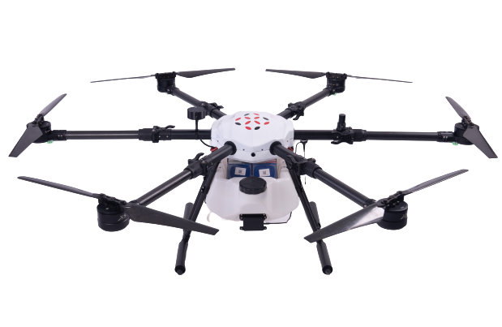
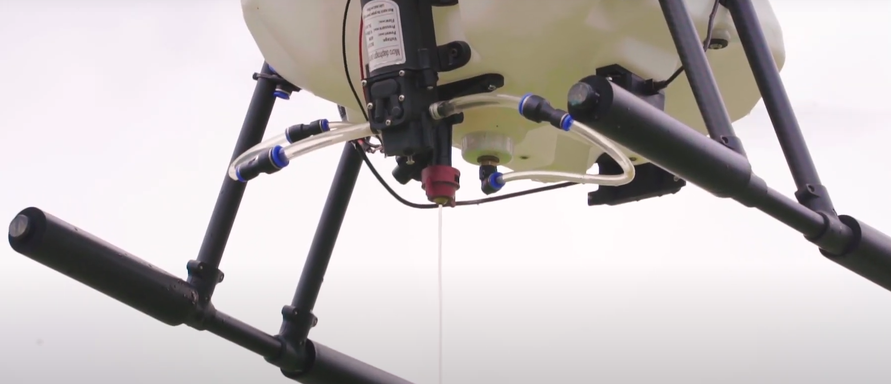
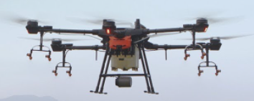
1) Robot Design Vs Task
Extinguishing Fire via
spraying water
The picture shows the water drizzled down the nozzle. With adjustment towards the nozzle, water could be
sprayed instead of drizzled down to extinguish fire.

Slide 10
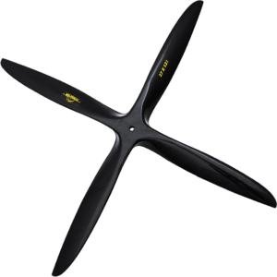
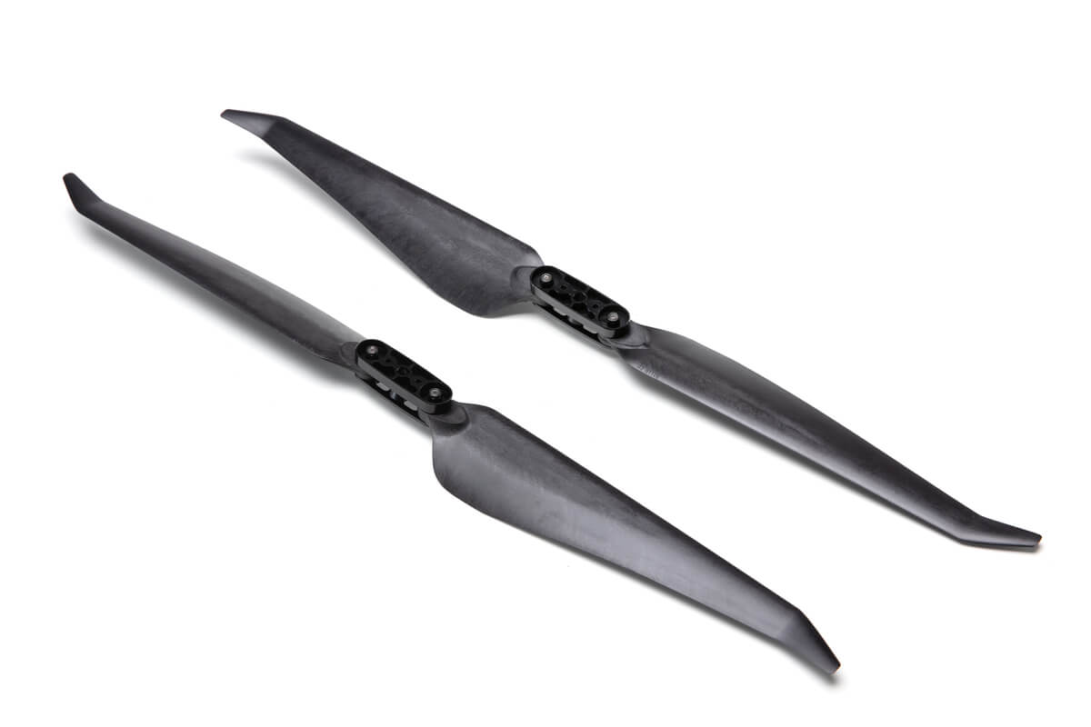
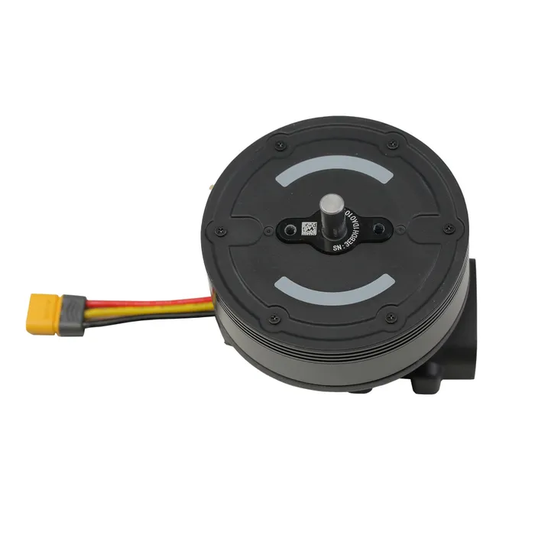
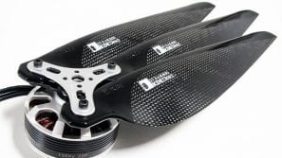
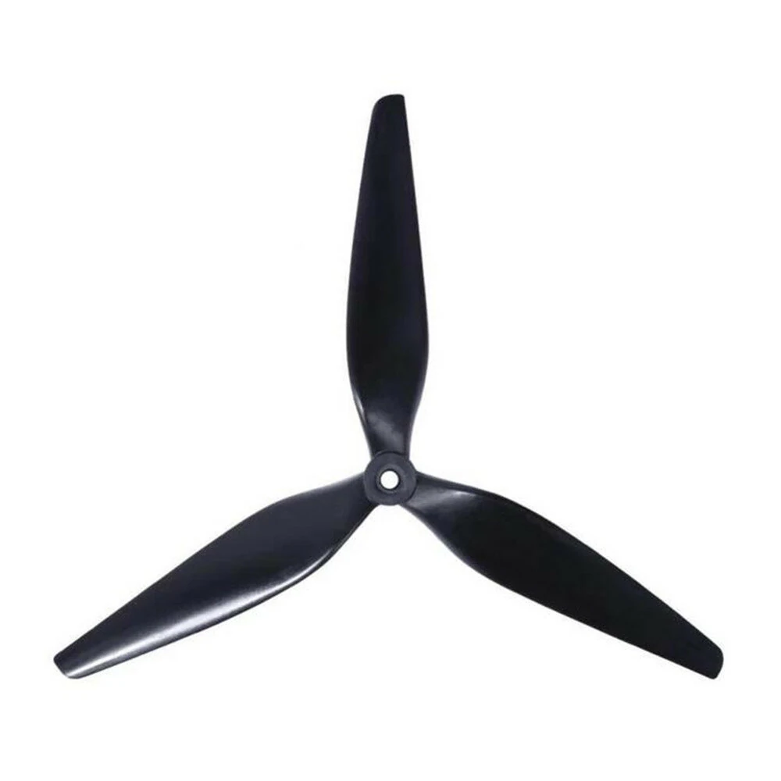
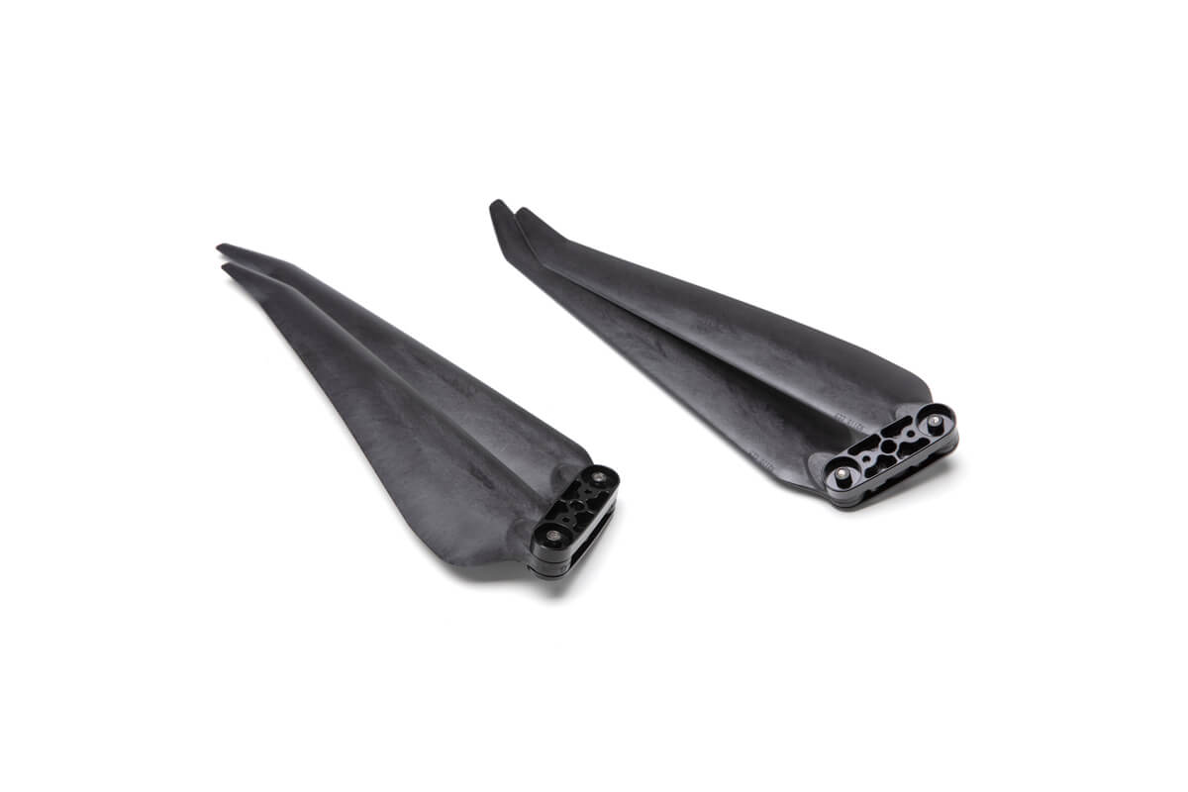
2) Actuators & Locomotion
Propellor

Slide 11
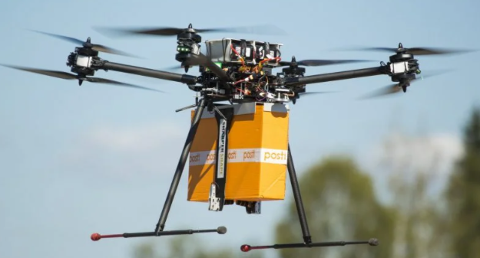
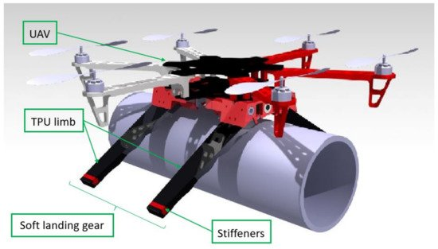
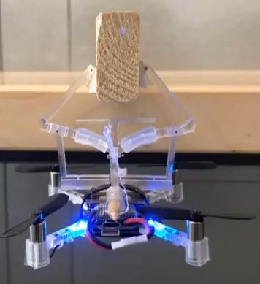
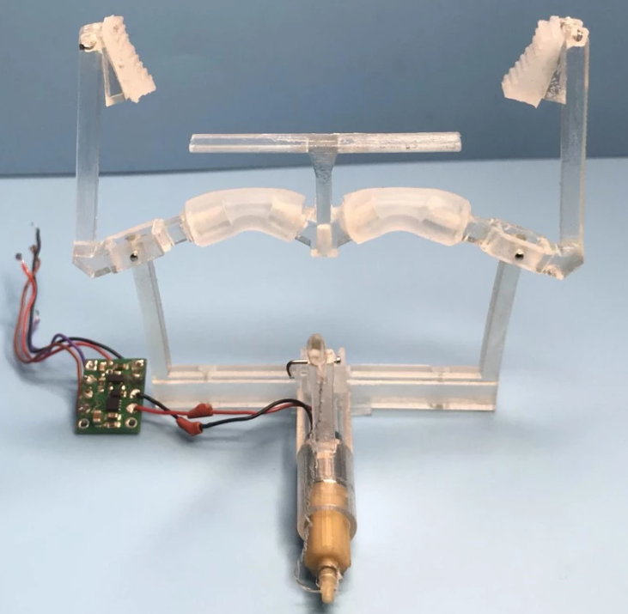
2) Actuators & Locomotion
Gripper

Slide 12
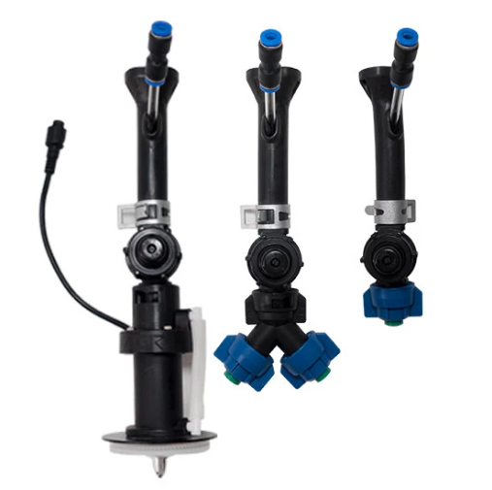
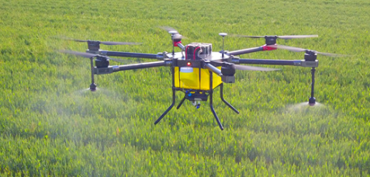
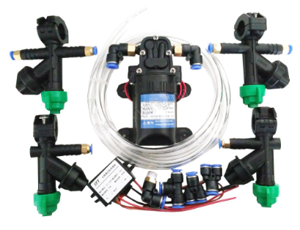
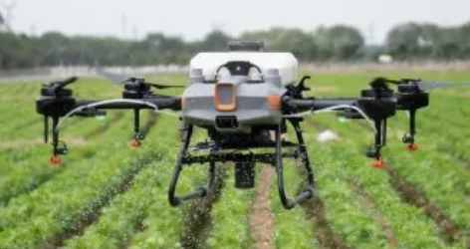
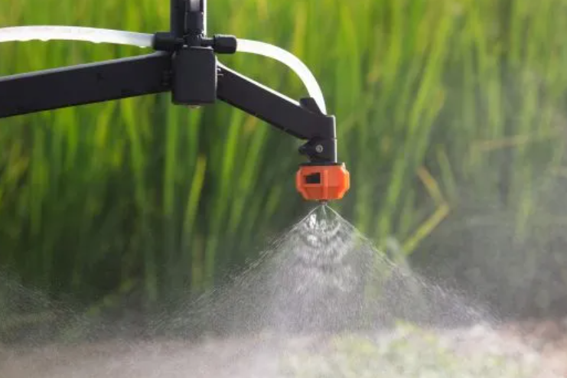
2) Actuators & Locomotion
Water Nozzle
Using pump to spray liquid.
Main usage is currently for agriculture.
But imagine changing it for extinguishing
fire.

Slide 13
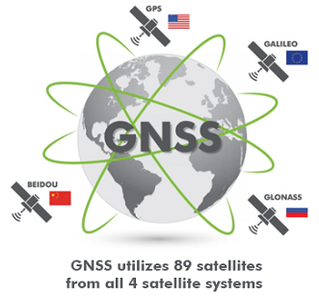
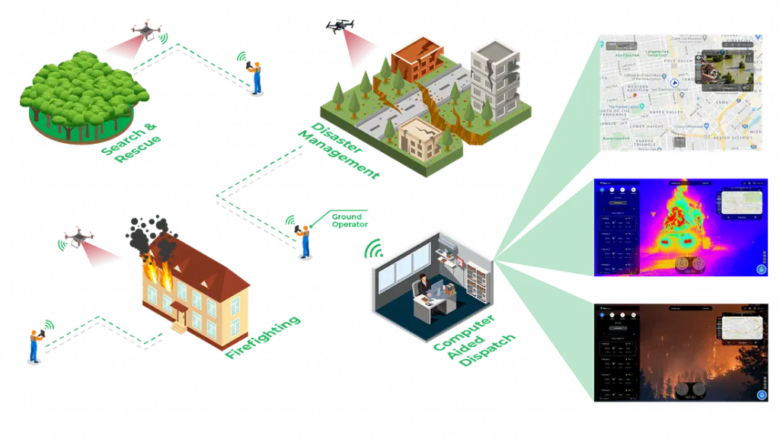
3) Navigation System & Controller
GNSS system to get the best navigation information
FlytNow cloud base service

Slide 14
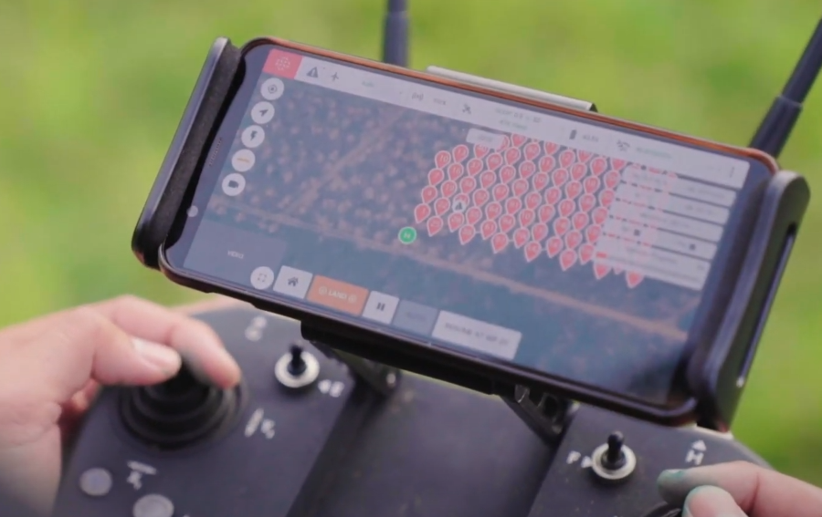
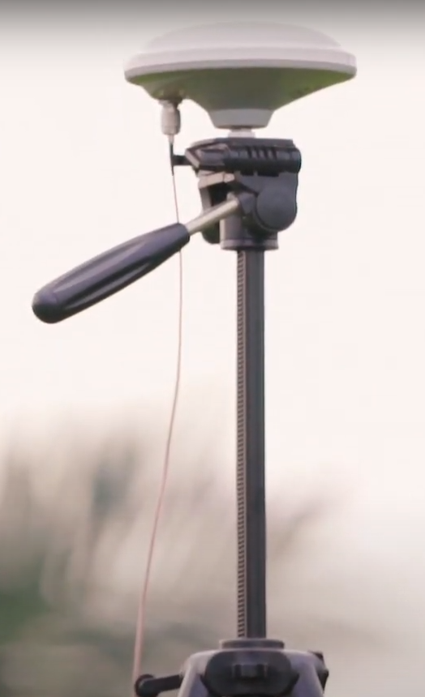

3) Navigation System & Controller
Beacon for RTK
GPS RTK

Slide 15
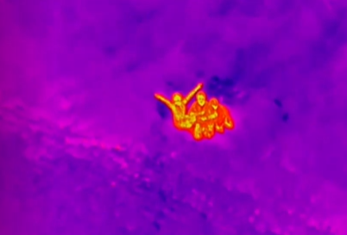
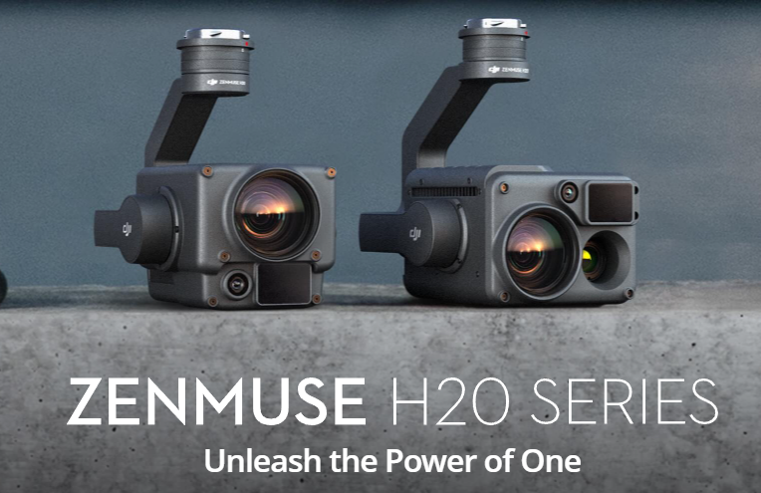
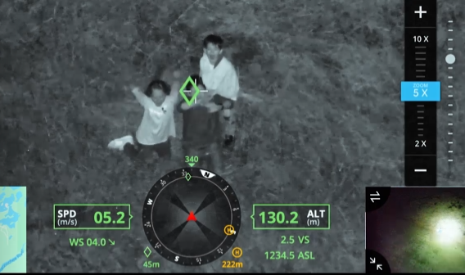
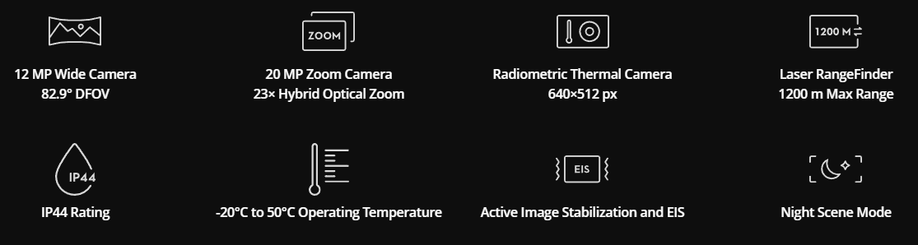
4) Data Collection
Thermal Camera plays a huge role in findings victims
Thermal View

Slide 16
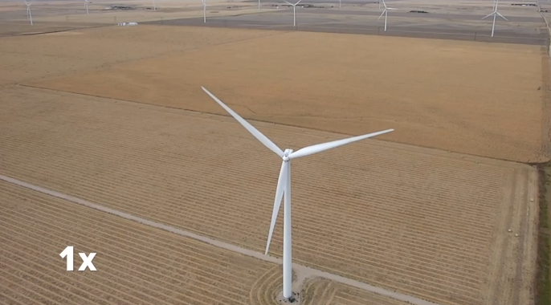
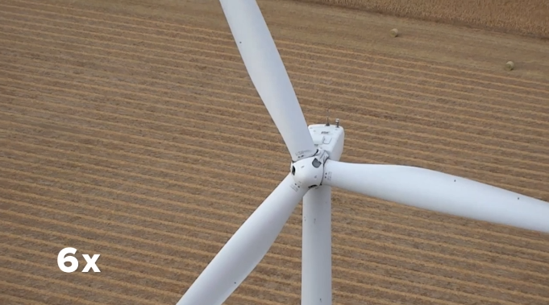
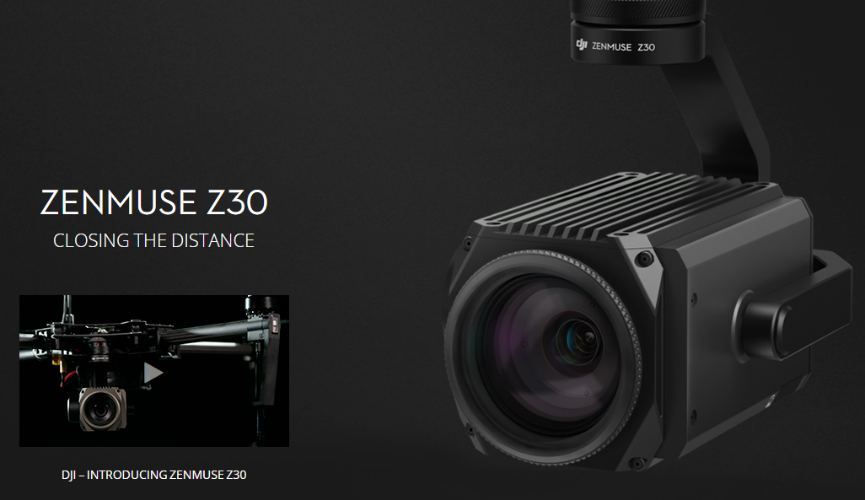
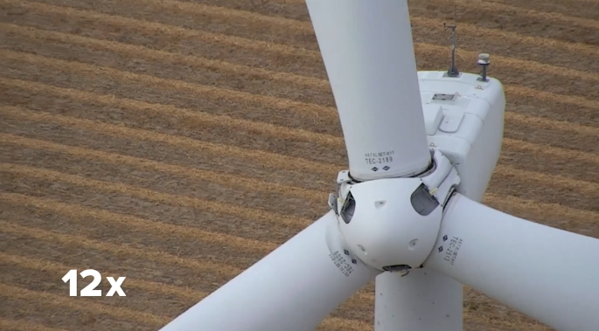
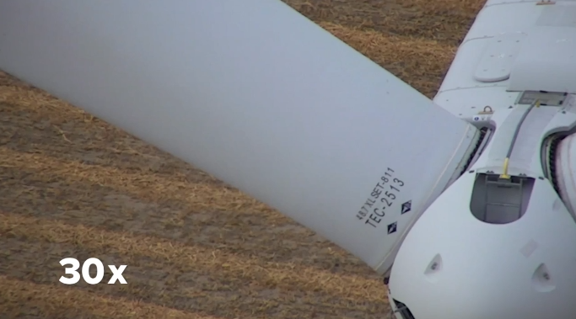
4) Data Collection
Long Range Viewer
30X Optical zoom makes it the greatest
surveyor to be used to search people
from a high place.

Slide 17
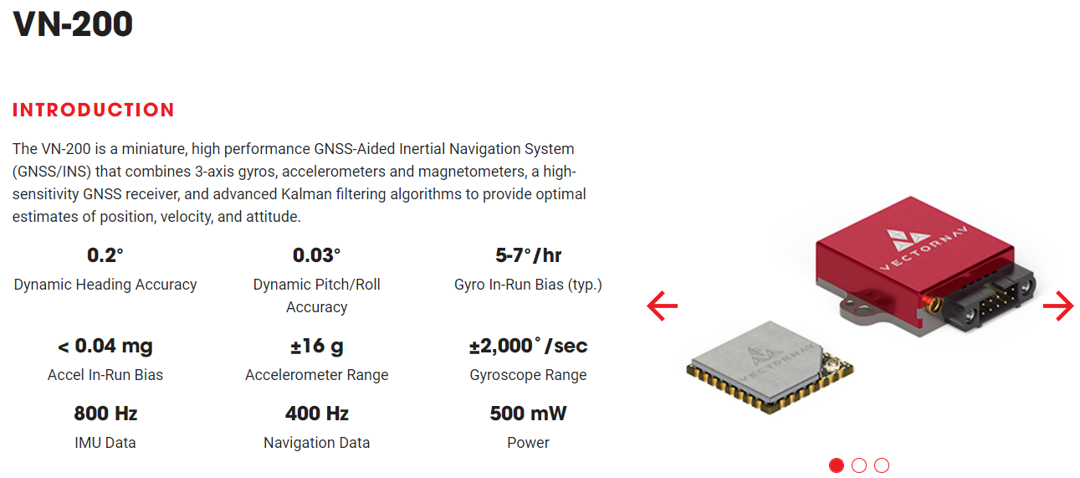
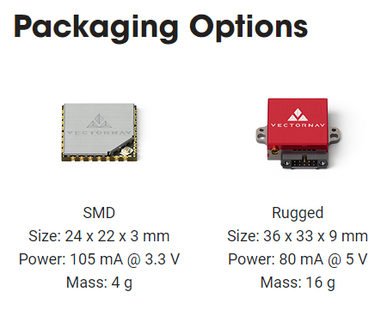
4) Data Collection
Orientation, Motion and Heading

Slide 18




5) Data Transmission
First Person View
People can perceive the first person view
of the drone.

Slide 19




5) Data Transmission
Radio Receiver
Radio Frequency
Remotely control the drone

Slide 20




6) Power System Management
Battery with
Fast Charging
Station
BS60 Intelligent Battery Station
WB37 Intelligent Battery

Slide 21



6) Power System Management
Tethered Drone
Winch system to keep wire neatly coiled

Slide 22
UAV Companies in Malaysia
Poladrone https://poladrone.com/about_us.html
Vortex Edge Sdn Bhd http://www.vortex-edge.com/uav-solutions/
Malayisia UAV Developments Association https://muda.org.my/
DEFTECH https://www.deftechust.com/copy-of-products
Dragonfly Robotix https://www.dragonflyrobotix.com/
Kambyan Network https://www.kambyan.net/
DroneCult https://www.dronecult.photography/

